Slide 1
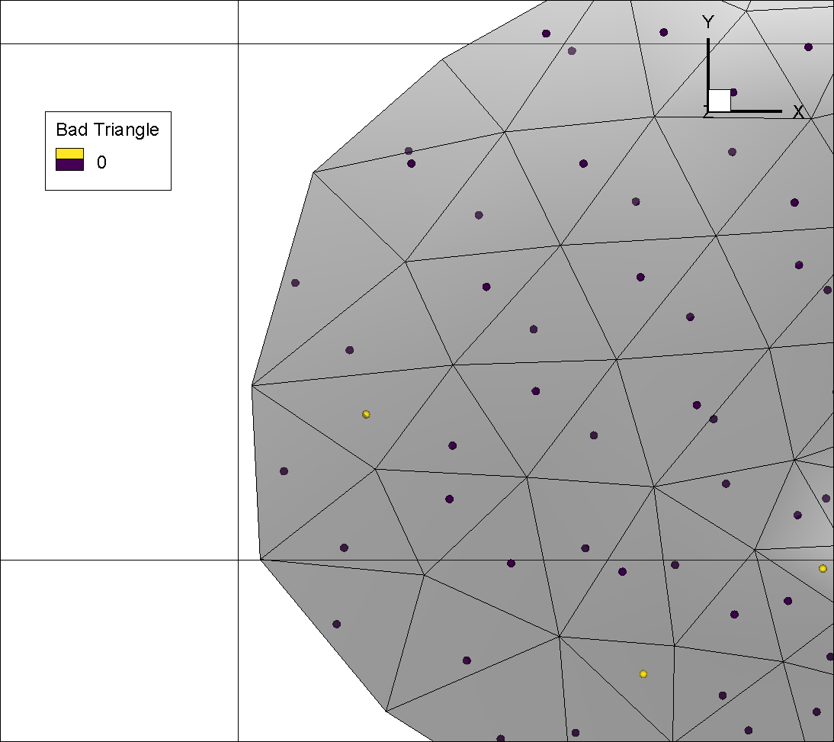
The outer (or circum) circle is defined to intersect all 3 triangle nodes, while the inner circle is defined to be tangent to all 3 triangle sides.
To the left, outer circle centres are shown by the blue spheres. Many are located just inside the triangle (e.g. pt A) while some where completely outside the triangle and have been replaced by the inner circle centres as indicated by the yellow spheres (e.g. point B)
A
B

Slide 2
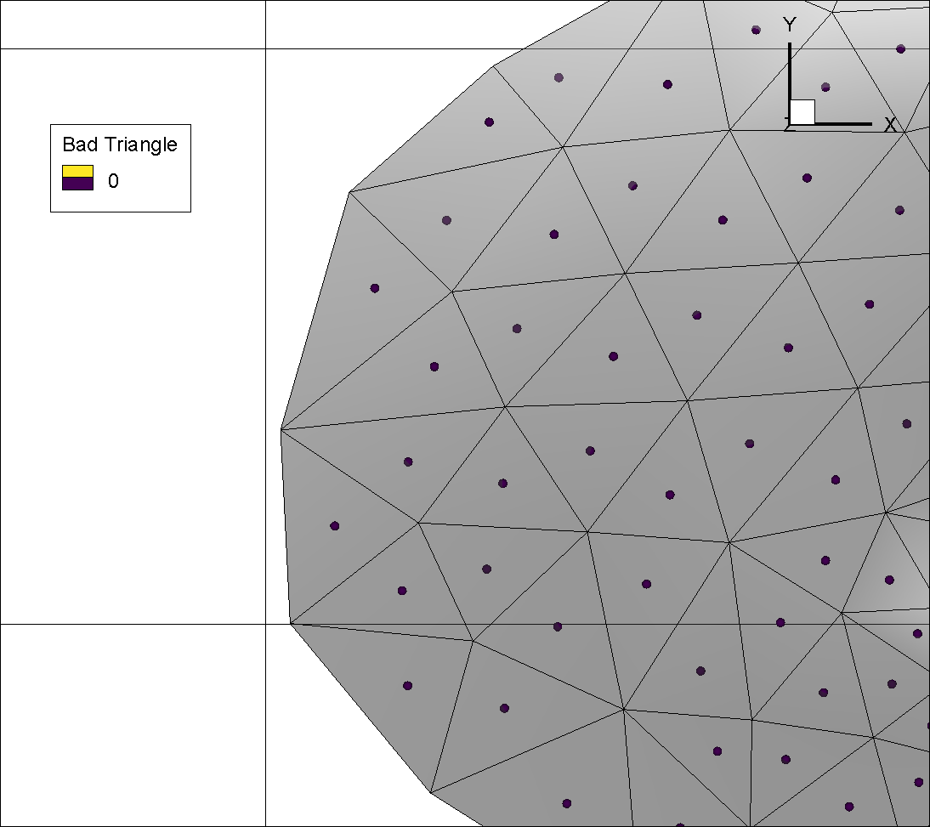
Here the inner circle centres have been used exclusively (blue shperes).

Slide 3
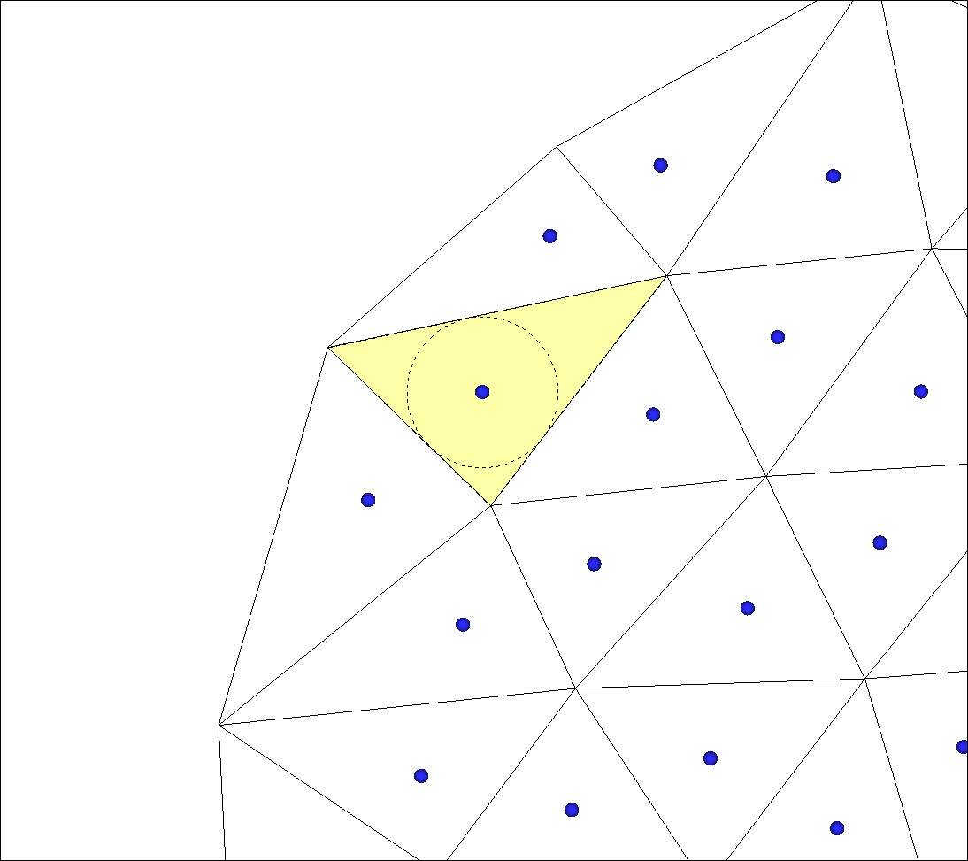
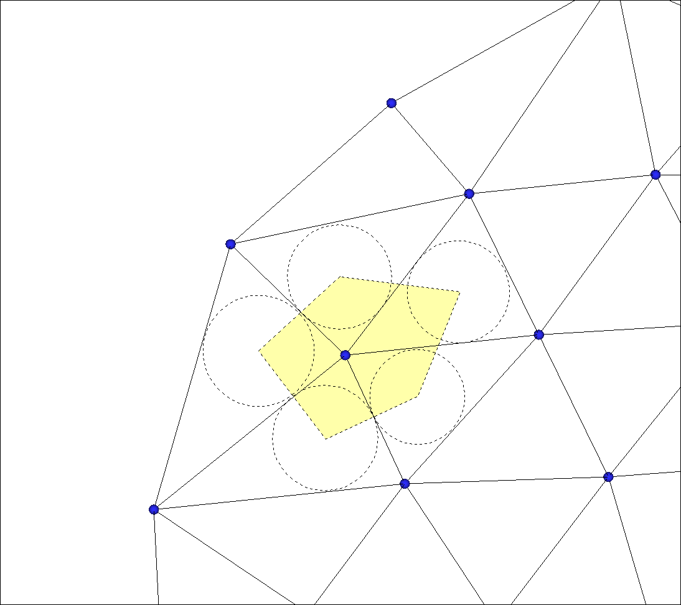
Mesh-centred control volume
Inner circle centres (blue circles) represent Modflow cells
Cell area (yellow shading) is equal to the triangular element area
Node-centred control volume
Triangular element nodes (blue spheres) represent Modflow cells
Cell area (yellow shading) is defined by the inner circle centres from all adjoining triangular elements

Slide 4
Mesh-centred Cell-to-cell Connections
Cell connection distance defined by sum of distance from circle centre to edge tangents (blue arrows) or distance between adjacent circle centres (dashed blue arrow)
Cell connection length (orange line) defined by triangular element side length
Node-centred Cell-to-cell Connections
Cell connection distance (blue arrow) defined by triangular element side length
Cell connection length defined by sum of distance from circle centre to edge tangents (orange lines) or distance between adjacent circle centres (dashed orange line)

Slide 5

2
D
Node-centred scheme cell area calculation
Cell areas can be calculated by summing the areas of the triangle pairs from the adjoining elements 1 to 5 in this case
Shown for element 1 are the blue triangles ABC and ACD
Points B and D are the intersection points between the element 1 sides and the lines between the adjoining element inner circle centres
1
C
3
B
A
5
4

Slide 6
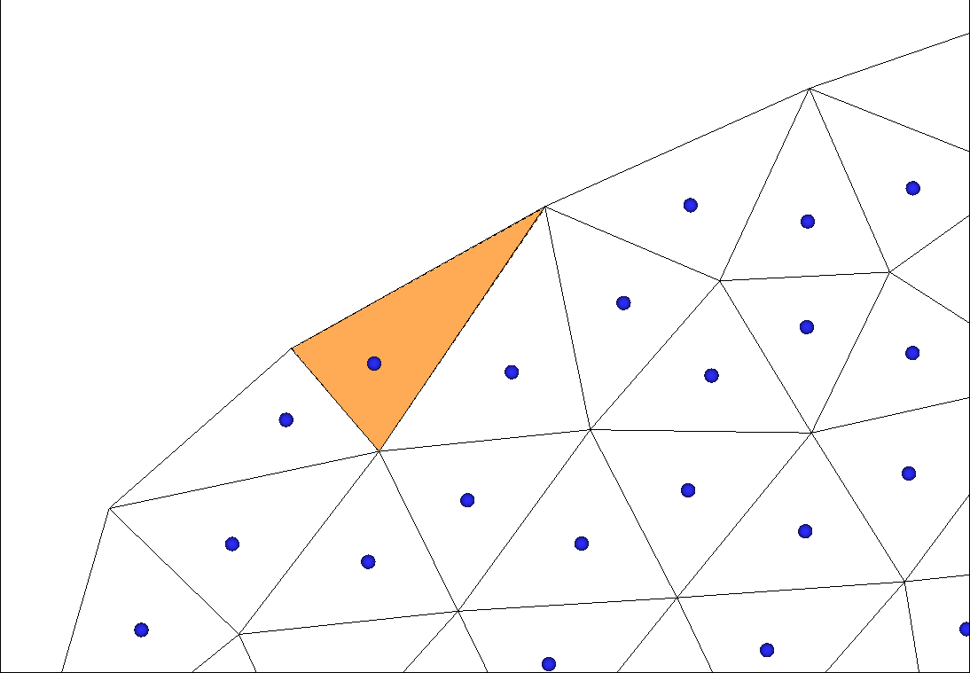
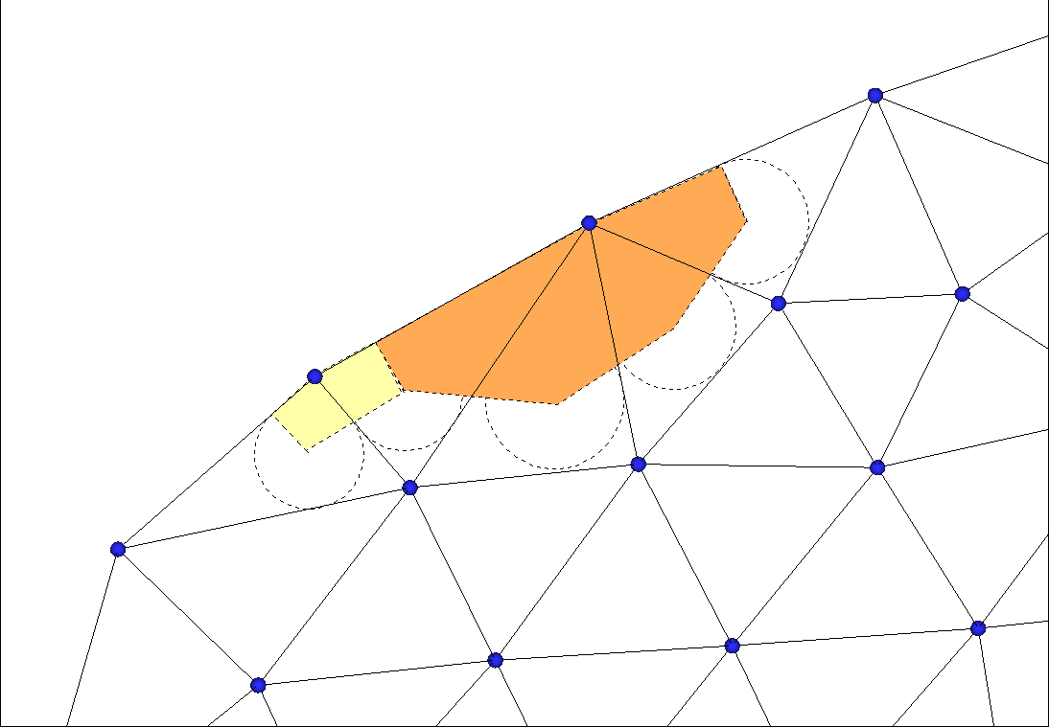
Mesh-centred boundary inflow
The contributing length used to calculate inflow to cell 1 is defined by the triangular element side length AB
Node-centred boundary inflow
The contributing length used to calculate inflow to the cell is defined by the lengths AB for the yellow shaded cell 1 and BC for the orange shaded cell 2
The point A,B and C are located at the intersection of the triangular element side and the perpendicular line to the inner circle centre.
Inflow to the larger cell 2 is balanced by a larger contributing length
C
B
2
B
A
1
A
1

Slide 7
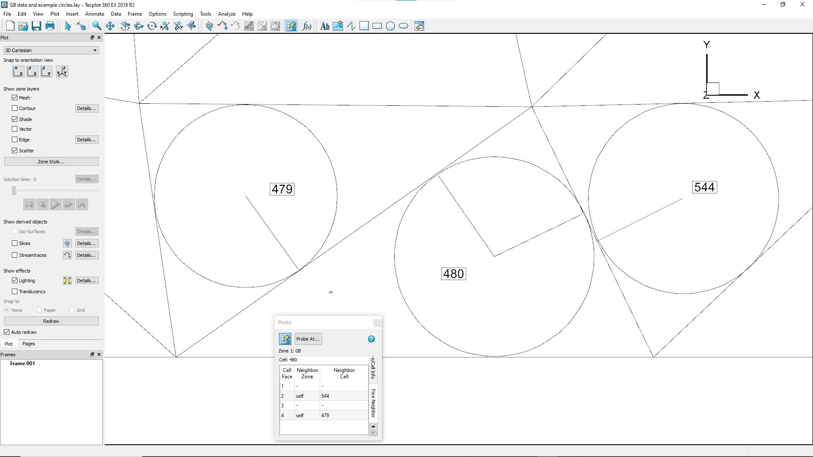
Tecplot face neighbours can be used to generate
connectivity lists for modflow cells

Slide 8
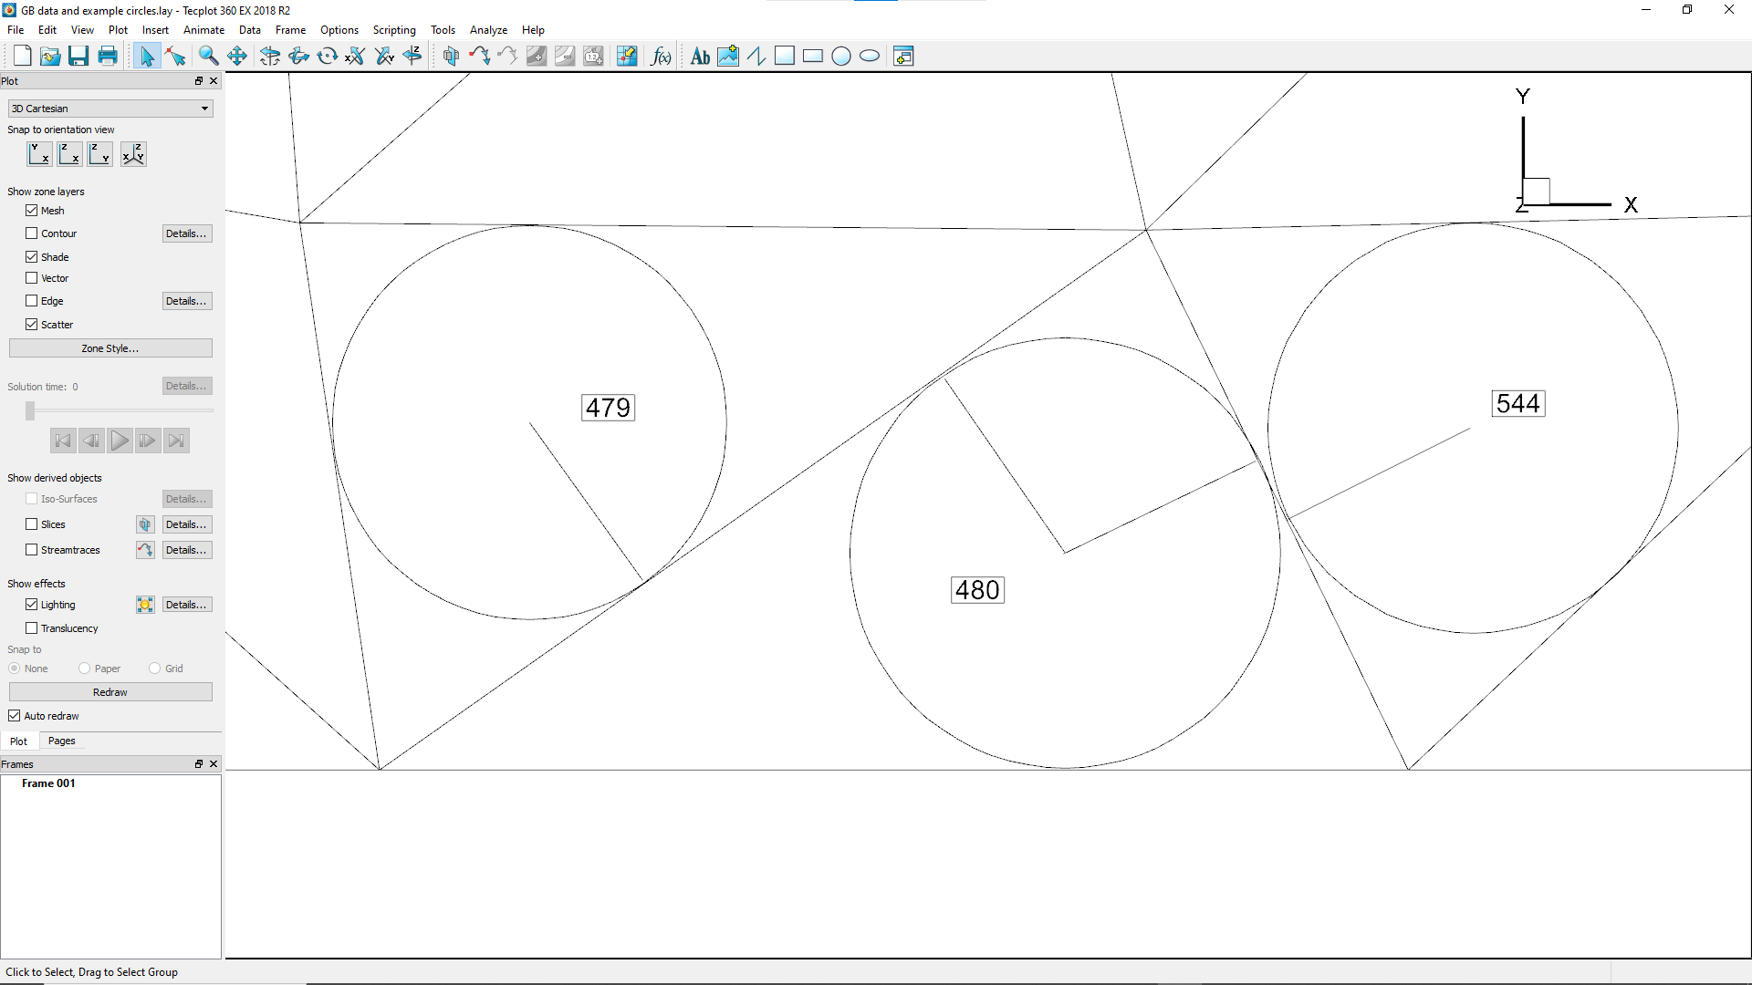
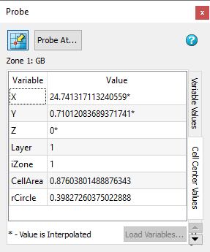
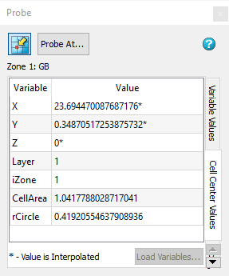
Cell area and circle radius can be used to
define flow distance and area for cell to cell connections

